Slide 1

19CSE454 - Information retrieval
GROUP 3 – CASE STUDY REVIEW
ALA VENKATA CHANDANA - CB.EN.U4CSE21005
ENUGURU YASHASWINI - CB.EN.U4CSE21017
TANGUDU HARSHA VARDHAN - CB.EN.U4CSE21062
V VIGNESH - CB.EN.U4CSE21068

Slide 2
INDEX
Dataset
Term-document Incidence Matrices
Tokenization
Normalization (Case Folding)
Stemming and Lemmatization
Inverted Index Construction
Document Parsing
Skip Pointers in Postings
Stop Words Removal
Query Processing
Boolean Retrieval Model
Proximity Queries
Phrase Queries
Efficient Query Execution
Skip Pointers to Optimize Query Processing
Soundex
Levenshtein Distance (Edit Distance)
Bigram (k-gram) Indexes
Jaccard Coefficient
Permuterm Index
Wild-card Queries
Spelling Correction
Corpus Parsing
Blocked Sort-Based Indexing (BSBI)
Merging Blocks
Single-Pass In-Memory Indexing (SPIMI)
Logging
Time Measurement
Error Handling
Inverted Index Compression
Conversion of Document IDs to Integers
Gap Encoding​
Variable-Length Encoding​
Variable Byte (VB) Codes​
Gamma Codes​
Dictionary Compression​
Blocking Compression​
Decompression of Inverted Index​
Statistical Analysis​
Heaps' Law​
Zipf's Law​
Evaluating Compression Performance​
Lossy Compression Concept​
Bag of Words​
Term Frequency (TF)​
Inverse Document Frequency (IDF)​
TF-IDF Weighting​
Log-Frequency Weighting​
Vector Normalization​
Cosine Similarity​
Cumulative TF-IDF Score Ranking​
Precision and Recall Calculations​
Handling Numeric Data​
Handling Multilingual Datasets​
Parallel Processing with Parsers and Inverters​
MapReduce​
Front Coding​
Document Length Normalization​
Positional Indexes​
Ranked Retrieval​
Challenging Concepts​
Distributed Indexing​
Dynamic Indexing​

Slide 3
DATASET
The WebAP dataset is a passage retrieval dataset sourced from the TREC Gov2 collection. It contains 8,027 answer passages spread across 6,399 documents, associated with 82 queries. Each passage is annotated with graded relevance judgments such as "perfect" or "excellent." This dataset focuses on passage-level retrieval, helping evaluate retrieval models by scoring passages based on their relevance to queries. It is designed for experiments in passage ranking and retrieval, particularly in answering complex questions.
<DOC>
<DOCNO>GX268-35-11839875-701</DOCNO>
<TARGET_QID>701</TARGET_QID>
<ORIGINAL_DOCNO>GX268-35-11839875</ORIGINAL_DOCNO>
<TEXT>
<NONE>
<SENTENCE>August 31, 1997 Members of the Legislative Budget and Audit Committee: In accordance with the provisions of Title 24 of the Alaska Statutes, the attached report is submitted for your review.</SENTENCE>
<SENTENCE>DEPARTMENT OF LABOR DEPARTMENT OF NATURAL RESOURCES OIL COMPANY HIRING, PROCUREMENT AND CONTRACTING ISSUES August 31, 1997 Audit Control Number 07-4560-97 As stated in the Objectives, Scope, and Methodology section of this report we reviewed, among other things, local hire, procurement and contracting within the oil industry in the State.</SENTENCE>
<SENTENCE>In addition, we reviewed the five year employment trend of the oil industry and inquired into recent activity by the State and the oil industry on local hire, procurement and contracting.</SENTENCE>
<SENTENCE>The audit was conducted in accordance with generally accepted government auditing standards.</SENTENCE>
<SENTENCE>Fieldwork procedures utilized in the course of developing the findings and discussion presented in this report are discussed in the Objectives, Scope, and Methodology section of this report.</SENTENCE>
<SENTENCE>Randy S. Welker, CPA Legislative Auditor</SENTENCE>

Slide 4
LECTURE 1 AND 2

Slide 5
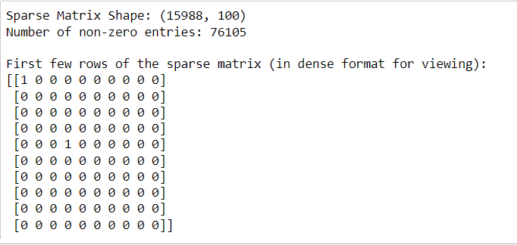
Term-document Incidence Matrices
In the WebAP dataset, a term-document incidence matrix is constructed by representing documents as rows and terms as columns, with binary values indicating whether a term appears in a document.
This matrix helps in binary retrieval, allowing us to quickly determine which documents contain specific terms, supporting fast lookup operations.
The incidence matrix allowed for efficient Boolean searches, providing a structured way to represent the presence of terms in documents, enabling faster retrieval of relevant passages.

Slide 6
Normalization (Case Folding)
In the WebAP dataset, normalization (case folding) converts all text to lowercase during preprocessing. This ensures that "Cat," "cat," and "CAT" are treated as the same term rather than distinct ones.
Normalization reduces inconsistencies caused by varying capitalizations. It ensures uniformity in the text, making it easier to search and index without case sensitivity, improving retrieval accuracy.
Case folding helped by ensuring that queries matched documents irrespective of case, enhancing the consistency and accuracy of the search results across the dataset.

Slide 7
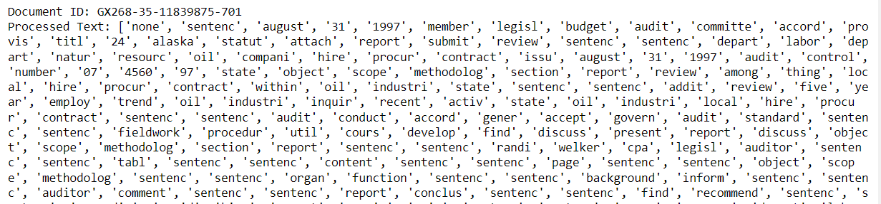
Tokenization
In the WebAP dataset, tokenization involves splitting the text from each passage into individual words or terms. Punctuation is typically removed, and the text is split at whitespace to generate tokens, which are then stored for further processing like indexing and querying.
Tokenization breaks down the text into manageable units (terms) that can be indexed and searched. This step is essential for any search and retrieval process because it prepares the data for analysis and matching.
Tokenization enabled us to handle the dataset more efficiently, allowing the system to process user queries by matching individual tokens (terms) from queries to the indexed terms. This made searching faster and more accurate in retrieving relevant passages from the dataset.

Slide 8
Stemming and Lemmatization
For the WebAP dataset, stemming reduces words to their root forms (e.g., "running" becomes "run"), while lemmatization converts words to their dictionary form based on context (e.g., "better" becomes "good").
Stemming and lemmatization help standardize different forms of the same word, improving search results by grouping related terms together, regardless of tense or suffix.
These techniques improved the recall and precision of our retrieval system by ensuring that different word variations (e.g., plural vs. singular) were treated as the same term, returning more relevant passages.

Slide 9
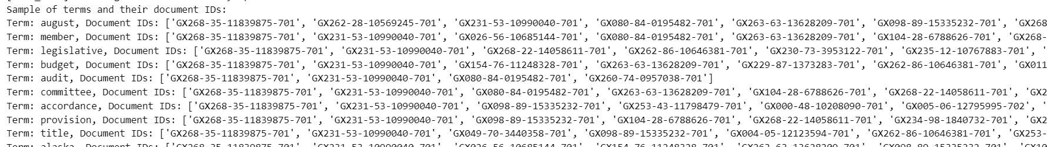
Inverted Index Construction
Inverted index construction takes the WebAP dataset's passages and creates a mapping of each unique term to the document IDs (or passage IDs) where that term appears. This process involves tokenizing the text into terms, normalizing them, and storing their occurrence locations (document or passage).
An inverted index enables efficient document retrieval by allowing fast lookups of which documents contain specific query terms. It's a foundational structure for search engines.
The inverted index is critical for achieving fast, ranked retrieval in the WebAP dataset. It allows users to quickly find the most relevant passages in response to a query, optimizing the system's speed and accuracy in locating relevant information based on term frequency and importance.

Slide 10
Document Parsing
In the WebAP dataset, document parsing involves breaking down raw documents into structured elements like tokens, sentences, or terms, preparing them for further indexing and analysis.
Document parsing is essential for converting unstructured text into a structured format that can be indexed, searched, and analyzed efficiently.
By parsing documents, the system could extract key terms and structure from each passage, enabling accurate indexing and retrieval for user queries.

Slide 11
Skip Pointers in Postings
Skip pointers are applied by adding "skips" or shortcuts within the posting lists of terms in the WebAP dataset. These pointers allow the system to skip over sections of the list during search, reducing the time needed for retrieval.
Skip pointers help improve efficiency by allowing faster access to relevant documents, especially for long posting lists in large datasets.
By using skip pointers, we significantly reduced the search time for queries, enabling quicker retrieval of passages from large posting lists.

Slide 12
Stop Words Removal
For the WebAP dataset, stop words removal involves identifying and eliminating common words (e.g., "the", "is", "and") from the tokenized text of passages. These words are deemed to have little or no relevance to the search queries.
Stop words contribute minimal value to the meaning of a document and can add noise to the indexing and search process. By removing them, we improve the relevance of retrieved results and reduce the storage and processing overhead.
Removing stop words reduced the size of the index, improving the efficiency and speed of the search process. It also ensured that only meaningful terms contributed to ranking documents, making results more accurate and focused on relevant content.

Slide 13
Query Processing
In the WebAP dataset, query processing involves interpreting user queries by breaking them down into tokens, analyzing their structure, and matching them with the indexed terms in the dataset. Techniques such as tokenization, stemming, and synonym matching are used.
Query processing helps in understanding and optimizing user queries, ensuring that the retrieval system matches relevant documents to user intent.
Effective query processing improved retrieval accuracy by ensuring the system could interpret queries correctly, handle variations, and return the most relevant passages.

Slide 14
Boolean Retrieval Model
The Boolean Retrieval Model is applied by creating a system where queries use Boolean operators like AND, OR, and NOT to retrieve passages from the WebAP dataset. The system identifies documents that either fully match or don't match based on the query structure.
Boolean retrieval allows for exact matching of query terms, making it suitable for users who need specific passages that match certain criteria.
It provided a simple, efficient way to retrieve relevant passages when precise matching was required, enabling quick filtering of the dataset.

Slide 15
Proximity Queries
In the WebAP dataset, proximity queries retrieve documents where the query terms appear within a specified distance of each other. This is handled by using positional indexes to track the locations of terms within documents.
Proximity queries are useful for refining search results where the relationship between terms is important, such as when terms must appear near each other to be relevant.
Proximity queries ensured more accurate retrieval by focusing on documents where the terms occur close to each other, improving the precision of search results

Slide 16
Pharse Queries
In the WebAP dataset, phrase queries retrieve documents where the query terms appear in the exact order specified by the user. This is achieved by using positional indexes that track the locations of terms within documents.
Phrase queries ensure that documents where terms appear in the correct sequence are given priority, making them ideal for specific phrase-based searches.
Phrase queries improved the precision of search results, enabling the retrieval of passages that exactly matched user expectations based on the query's term order.

Slide 17
Efficient Query Execution
In the WebAP dataset, efficient query execution involves using optimized data structures like inverted indexes, skip pointers, and caching techniques to quickly retrieve relevant documents in response to user queries.
Efficient query execution ensures faster response times and minimizes computational overhead, allowing the system to handle large datasets and complex queries effectively.
It improved the overall speed and performance of the retrieval system, ensuring users received results quickly, even with large or complex queries.

Slide 18
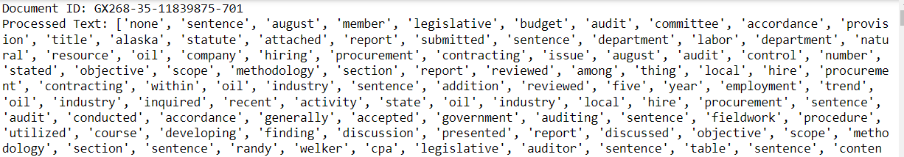
Skip Pointers to optimize Query Processing
In the WebAP dataset, skip pointers are used in the postings lists to allow the query processor to bypass sections of the list during searches. This enables the system to skip over non-relevant documents and quickly jump to potentially relevant ones.
Skip pointers are implemented to speed up query execution by reducing the number of comparisons required when searching through large postings lists.
Skip pointers significantly improved query processing speed, making retrieval faster and more efficient, especially for large datasets.

Slide 19
LECTURE 3

Slide 20
Soundex
In the WebAP dataset, Soundex is applied to handle phonetic matching for terms that sound similar but may be spelled differently.
We used these techniques to improve the system's ability to handle semantic variations and spelling errors, ensuring that related terms or misspellings still yield relevant results.
Soundex helped improve recall by retrieving passages with synonyms and similar-sounding terms, enhancing the system’s flexibility and accuracy.

Slide 21
Levenshtein Distance (Edit Distance)
In the WebAP dataset, Levenshtein distance is used to calculate the number of single-character edits (insertions, deletions, or substitutions) needed to change one term into another. This helps in identifying similar words for spelling correction.
Levenshtein distance helps handle spelling errors or variations in queries by identifying closely related terms.
It improved search accuracy by correcting minor misspellings in user queries, ensuring that relevant passages were retrieved even with typographical errors.

Slide 22
Bigram (k-gram) Indexes
Bigram (or k-gram) indexes are built by breaking down terms in the WebAP dataset into sequences of two or more characters (e.g., "search" becomes "se", "ea", "ar", etc.). These indexed fragments help in handling partial matches.
Bigram indexes allow for efficient handling of wild-card queries and help in detecting and correcting spelling errors by matching term fragments.
By using bigram indexes, we improved the system’s ability to handle partial matches and error tolerance, leading to better and more flexible search results.

Slide 23
Jaccard Coefficient
The Jaccard Coefficient is applied by comparing the intersection and union of the terms in a query and a document, calculating the overlap between them. It measures the similarity between sets of terms.
We use the Jaccard Coefficient to compute the similarity between query and document sets, especially when exact matching isn't needed.
The Jaccard Coefficient provided a simple and effective method to rank passages based on how much they shared common terms with the query, improving retrieval accuracy.

Slide 24
Permuterm Index
In the WebAP dataset, a permuterm index is created by generating permutations of terms, allowing for efficient handling of wild-card queries (e.g., "ca*ion" for "caution"). The index stores these permuted terms and their associated documents.
The permuterm index is applied to handle wild-card queries more efficiently, enabling users to search for terms with incomplete or variable character sequences.
It improved the system’s ability to process wild-card searches, allowing users to retrieve documents with terms that partially match their query.

Slide 25
Wild-card Queries
Wild-card queries are applied by using a special index, like a permuterm or k-gram index, which allows for efficient matching of partial terms or queries with missing characters (e.g., "te*t" to match "test").
We used wild-card handling to enable more flexible searches, allowing users to search for terms even when they don't know the full spelling.
Handling wild-card queries allowed the system to retrieve relevant passages more accurately when users provided incomplete terms, improving the overall search experience.

Slide 26
Spelling Correction
In the WebAP dataset, spelling correction is implemented by analyzing query terms and identifying possible misspellings using algorithms like Levenshtein (edit) distance. The system then suggests correct or similar terms.
Spelling correction is necessary to ensure that user errors in queries don’t result in missed relevant documents, improving the search system's tolerance to typographical mistakes.
Spelling correction improved search accuracy, ensuring that users retrieved relevant results even when queries contained minor spelling errors.

Slide 27
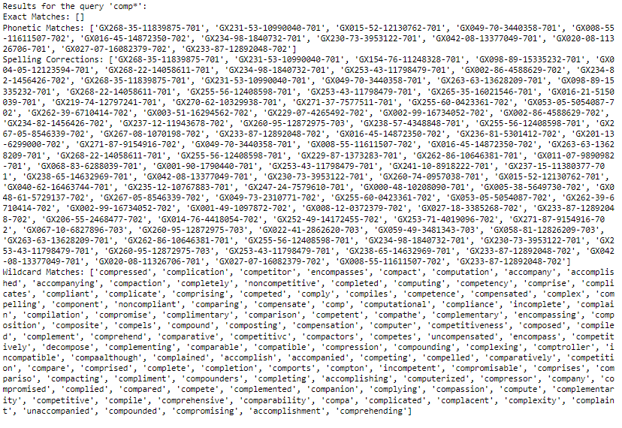
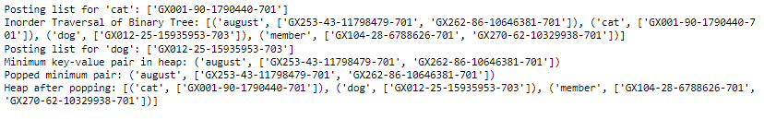

Slide 28
LECTURE 6

Slide 29
Bag of Words
In the WebAP dataset, the Bag of Words model represents each document as a collection of individual terms, disregarding grammar and word order. Each term’s frequency is recorded, but the relationships between terms are not considered.
The Bag of Words model simplifies the text by treating each document as a set of independent terms, making it easier to index and retrieve based solely on term frequency.
It enabled efficient term-based indexing and retrieval, providing a straightforward method to compare query terms with documents.

Slide 30
Term Frequency (TF)
In the WebAP dataset, term frequency (TF) is applied by counting how many times a term appears in a document. This value is used to assess the importance of the term within that specific document.
TF helps quantify the relevance of a term within a document, giving higher importance to terms that appear more frequently.
By using TF, the system could better assess a document's relevance based on the prominence of the query terms within the document, improving ranking accuracy.

Slide 31
Inverse Document Frequency (IDF)
In the WebAP dataset, IDF is applied by calculating how rare a term is across all documents. Terms that appear in fewer documents receive a higher IDF score, reflecting their uniqueness and importance.
IDF is used to weigh rare terms more heavily than common ones, ensuring that unique terms contribute more to the document's relevance score.
IDF helped emphasize important, rare terms in the dataset, improving the precision of retrieval by highlighting more relevant documents.

Slide 32
TF-IDF Weighting
TF-IDF is applied by calculating the term frequency (TF) for each word in a passage and multiplying it by the inverse document frequency (IDF) across the dataset. This assigns higher weights to important, rare terms.
To prioritize significant words that are frequent within specific passages but uncommon across the entire dataset, improving relevance.
TF-IDF helped us rank passages effectively by assigning greater weight to important, rare terms, boosting the retrieval system's accuracy.

Slide 33
Log-Frequency Weighting
In the WebAP dataset, logarithmic term frequency is applied by calculating the logarithm of the raw term frequency (TF) for each term in a document. This reduces the weight of terms that appear very frequently and helps to normalize the impact of term frequency on the overall score.
Logarithmic term frequency is used to ensure that high-frequency terms do not disproportionately affect document relevance scores, providing a more balanced representation of term importance.
It improved the accuracy of relevance scoring, allowing for a more equitable assessment of documents based on their term frequencies.

Slide 34
Vector Normalization
In the WebAP dataset, vector normalization is applied by adjusting the magnitude of document and query vectors to a standard length, often using the L2 norm. This ensures that each vector has a uniform scale, typically converting them into unit vectors.
Normalization is crucial to ensure that the comparison between vectors (e.g., for cosine similarity) is meaningful and not skewed by the length of the documents.
Vector normalization enhanced the accuracy of similarity measurements, allowing for fair and effective ranking of documents based on their relevance to the query.

Slide 35
Cosine Similarity
Cosine similarity is applied by calculating the cosine of the angle between the query vector and the document vector, using their TF-IDF weights. This gives a score representing how similar the two vectors are.
We use cosine similarity to measure the relevance of a document to a query, providing a mathematical way to rank documents based on their content overlap.
Cosine similarity helped in effectively ranking passages based on their closeness to the query, ensuring that the most relevant passages were prioritized in search results.

Slide 36
Cumulative TF-IDF Score Ranking
In the WebAP dataset, cumulative TF-IDF score ranking is applied by calculating the TF-IDF scores for each term in a document and summing these scores for all terms in response to a query. This creates a single score representing the overall relevance of each document.
Cumulative scoring allows for an aggregate evaluation of documents based on their term relevance, making it easier to rank them effectively.
This method facilitated the retrieval of the most relevant documents by providing a clear ranking based on cumulative importance, enhancing search result quality.

Slide 37
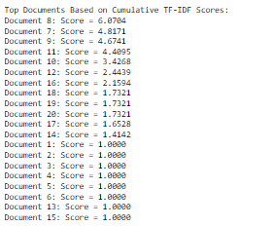
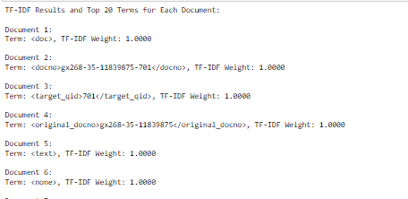
OUTPUT

Slide 38
LECTURE 4

Slide 39
Corpus Parsing
In the WebAP dataset, corpus parsing involves processing the entire collection of documents to extract structured elements like terms, phrases, or entities. This step is crucial for creating a searchable index by organizing the text data.
Corpus parsing helps break down the entire dataset into manageable units, enabling efficient indexing and retrieval.
Parsing the corpus allowed for structured indexing, making it possible to handle queries and retrieve relevant documents from a large dataset accurately.

Slide 40
Blocked Sort-Based Indexing (BSBI)
In the WebAP dataset, BSBI is applied by breaking the dataset into smaller manageable blocks. Each block is processed in memory, creating partial indexes that are later merged to form the final inverted index.
BSBI is used to efficiently handle large datasets that cannot fit entirely in memory by processing and sorting blocks independently, reducing the memory overhead.
BSBI enabled the system to scale by managing memory effectively, allowing for efficient index construction even for large datasets like WebAP.

Slide 41
Merging Blocks
In the WebAP dataset, merging blocks involves combining smaller, independently processed blocks of data or postings lists into a unified index. Each block is processed separately and then merged in a multi-way merge step.
Merging blocks allows the system to efficiently handle large datasets that are processed in smaller chunks, improving scalability and memory management.
Merging blocks ensured efficient index construction, enabling the retrieval system to scale effectively and handle large amounts of data while maintaining fast query performance.

Slide 42
Single-Pass In-Memory Indexing (SPIMI)
In the WebAP dataset, SPIMI processes one block of documents at a time, generating postings lists for terms directly in memory without sorting them. Each block’s index is written to disk, and then the final index is created by merging these partial indexes.
SPIMI is ideal for memory efficiency, as it processes one block at a time and doesn’t require sorting, making it suitable for large datasets like WebAP.
SPIMI allowed for faster index construction with reduced memory usage, improving the efficiency of handling large document collections.

Slide 43
Logging
In the WebAP dataset, logging involves recording details of query executions, document retrievals, and system operations for analysis. This can include query times, document access, and error tracking.
Logging is crucial for monitoring system performance, debugging issues, and ensuring the system operates efficiently by tracking its behavior and usage patterns.
Logging provided valuable insights into system performance and usage, helping optimize the retrieval process and troubleshoot any operational issues.

Slide 44
Time Mesurement
In the WebAP dataset, time measurement is applied to track how long it takes to execute queries, retrieve documents, and complete indexing. This involves capturing start and end times for specific processes to calculate total elapsed time.
Time measurement helps in assessing the performance of the system, allowing for optimizations and ensuring the system meets efficiency goals.
It provided insights into system speed, helping identify bottlenecks and improve query execution and retrieval times.

Slide 45
Error Handling
In the WebAP dataset, error handling involves anticipating and managing potential issues during query processing, indexing, or retrieval. This includes handling invalid queries, missing data, or unexpected system failures by logging errors and providing informative feedback.
Error handling ensures the system can gracefully recover from failures, maintaining reliability and providing meaningful responses to the user when issues arise.
It improved system stability and user experience by preventing crashes and enabling smooth operation, even in cases of errors or invalid input.

Slide 46
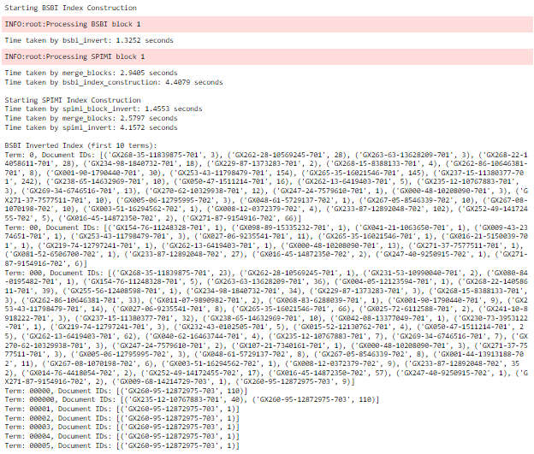
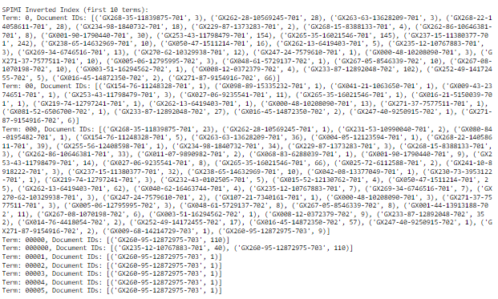
OUTPUT

Slide 47
LECTURE 5

Slide 48
Inverted Index Compression
In the WebAP dataset, inverted index compression involves reducing the size of the index by applying techniques such as variable-length encoding (e.g., variable byte codes or gamma codes) to compress the document IDs and posting lists.
Compression reduces the storage requirements for the inverted index, allowing the system to handle large datasets more efficiently while maintaining quick access to data.
Inverted index compression improved storage efficiency and sped up retrieval by reducing the size of the index, making data access faster and more resource-efficient.

Slide 49
Conversion of Document IDs to Integers
In the WebAP dataset, document IDs are converted to integers during indexing. Each document is assigned a unique integer ID, which simplifies storage and processing in the inverted index.
By using integers instead of complex identifiers, we reduce storage space and make operations like searching and sorting faster and more efficient.
It improved retrieval speed and efficiency, as integer-based operations are faster and take up less space in the inverted index compared to using full document identifiers.

Slide 50
Gap Encoding
In the WebAP dataset, gap encoding is applied by storing the differences (gaps) between consecutive document IDs rather than the actual document IDs in the postings lists. This reduces the size of the postings, especially when document IDs are closely spaced.
Gap encoding reduces storage requirements by representing document IDs more compactly, especially when documents are indexed in sequence.
Gap encoding made the inverted index more space-efficient while maintaining fast lookup and retrieval performance.

Slide 51
Variable-Length Encoding
In the WebAP dataset, variable-length encoding is applied to compress the postings lists by encoding document IDs or gaps using fewer bits for smaller values. The encoding adapts based on the size of the numbers.
We applied variable-length encoding to reduce the space required for storing postings, improving the efficiency of data storage and retrieval.
Variable-length encoding significantly reduced the storage overhead, allowing faster retrieval of postings due to compressed data structures.

Slide 52
Variable Byte (VB) Codes
In the WebAP dataset, Variable Byte (VB) codes are used to compress the postings lists by encoding gaps between document IDs. Each gap is encoded using a variable number of bytes, with smaller gaps taking fewer bytes.
VB codes reduce the space required for storing large postings lists, optimizing both storage and retrieval performance.
VB codes improved storage efficiency while maintaining fast decoding, resulting in a more compact and responsive retrieval system.

Slide 53
Gamma Codes
In the WebAP dataset, Gamma codes are used to compress the gaps between document IDs in the postings lists. Gamma coding represents each gap using a unary code for the length and a binary code for the actual value.
Gamma codes help reduce the storage size of postings by encoding smaller numbers with fewer bits, making the index more space-efficient.
Gamma codes provided a highly space-efficient way to store document IDs, reducing the overall size of the index while maintaining retrieval speed.

Slide 54
Dictionary Compression
In the WebAP dataset, dictionary compression is applied by using techniques such as front coding or blocking, where common prefixes among terms are stored only once, and pointers are used to reduce redundancy.
Dictionary compression reduces the memory footprint of the dictionary, ensuring that it consumes less space while maintaining quick lookup times.
It enabled more efficient use of memory, allowing the system to handle larger dictionaries and speed up search operations by reducing storage overhead.

Slide 55
Blocking Compression
In the WebAP dataset, blocking compression is applied by storing pointers for only every kth term in the dictionary, rather than for each term individually. This reduces the number of pointers stored in memory, compressing the dictionary.
Blocking compression optimizes memory usage by reducing the amount of storage needed for term pointers, while still allowing efficient term lookups.
It provided a more space-efficient dictionary structure, helping manage large datasets without sacrificing lookup speed.

Slide 56
Decompression of Inverted Index
In the WebAP dataset, decompression of the inverted index is performed when retrieving data. Compressed data, such as document IDs or gaps encoded with techniques like Variable Byte or Gamma codes, is decompressed during query processing to reconstruct the original postings lists.
Decompression is essential for restoring the compressed data into its usable form for query processing and document retrieval.
Decompression allowed the system to efficiently store data while ensuring fast access and retrieval during query execution.

Slide 57
Statistical Analysis
In the WebAP dataset, statistical analysis involves analyzing term frequencies, document lengths, and query performance metrics like precision and recall. Techniques such as calculating averages, variances, and distributions help in understanding patterns in the data.
Statistical analysis is applied to assess the effectiveness of the retrieval system, enabling optimizations by identifying trends and areas of improvement.
It helped us evaluate system performance and optimize retrieval accuracy by understanding data trends, allowing for informed adjustments to the search algorithms.

Slide 58
Heaps' Law
In the WebAP dataset, Heaps' Law is used to estimate the growth of the vocabulary size as the number of documents increases. It suggests that the number of unique words in a corpus grows at a slower rate than the size of the corpus itself.
Heaps' Law helps predict vocabulary size and assess the richness of the dataset, which is crucial for understanding the complexity of the language used.
Understanding vocabulary growth enabled better indexing strategies and resource allocation, ensuring efficient processing as the dataset scales.

Slide 59
Zipf's Law
In the WebAP dataset, Zipf's Law is used to analyze the frequency distribution of terms, indicating that a small number of terms are used very frequently, while most terms are rare. This relationship helps in understanding term usage patterns.
Zipf's Law assists in predicting the distribution of term frequencies, guiding decisions on indexing and storage strategies based on expected term frequency behavior.
It informed the design of more efficient retrieval algorithms, optimizing the system for common queries and terms, ultimately enhancing performance and resource allocation.

Slide 60
Evaluating Compression Performance
In the WebAP dataset, evaluating compression performance involves measuring the effectiveness of compression algorithms by assessing factors like compression ratio, speed, and impact on retrieval times. This analysis compares the size of compressed data against the original.
Evaluating compression performance is crucial to ensure that the trade-off between storage efficiency and retrieval speed is optimized for system performance.
It provided insights into the effectiveness of different compression techniques, guiding decisions to enhance system efficiency and overall performance.

Slide 61
Lossy Compression Concept
In the WebAP dataset, lossy compression involves reducing data size by permanently eliminating some information, particularly less critical details, to achieve higher compression ratios. This method might be applied to textual data where slight information loss is acceptable.
Lossy compression is used to significantly reduce storage requirements, making it easier to handle large datasets without requiring excessive resources.
It allowed for more efficient data management while balancing the need for performance and acceptable quality loss in certain retrieval tasks.

Slide 62
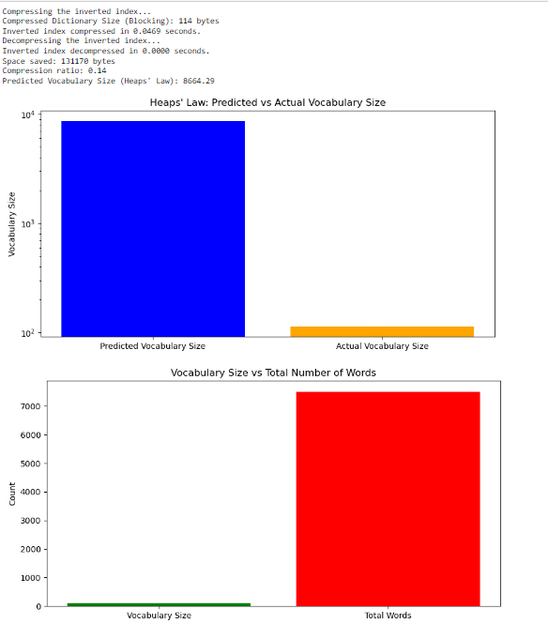
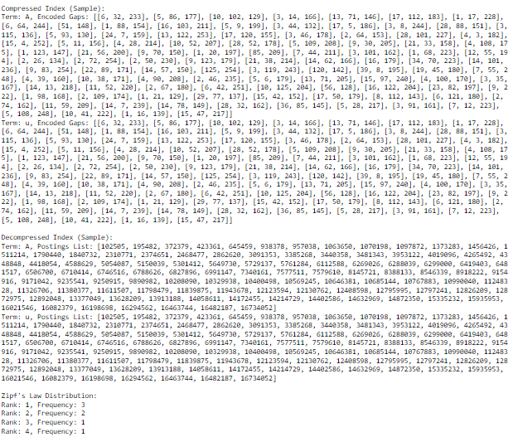
OUTPUT

Slide 63
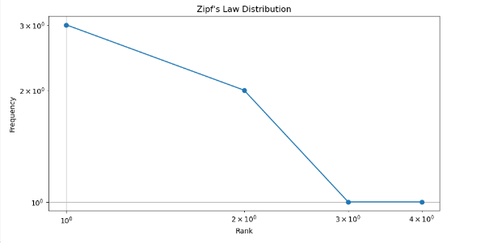

Slide 64
THANK YOU

